Slide 1
Data Science Mini Project
League of legends dataset
Elias, Raj, Brandon

Slide 2
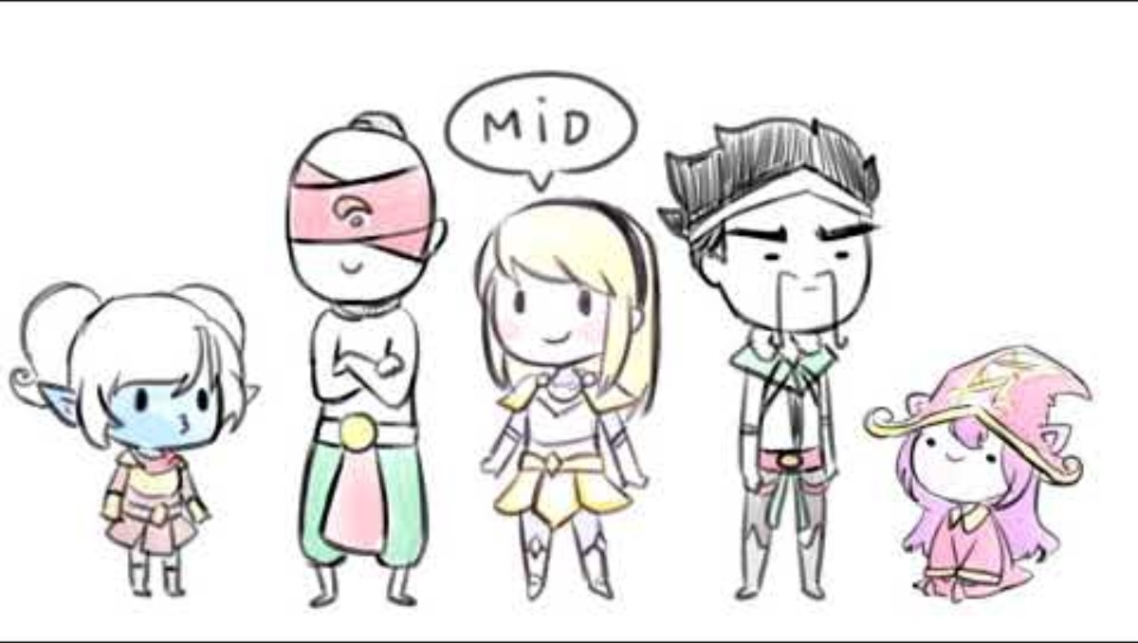
introduction League Of Legends
League of Legends (LoL) one of the most popular online games worldwide, boasting millions of players.
5v5 Multiplayer Online Battle Arena (MOBA), where teams fight against each other in a virtual battlefield called the summoners rift.
League of Legends is a strategic game that demands teamwork, skill, and adaptability.
Notes:
League of Legends developed by Riot Games, is often abbreviated as LoL stands as one of the most popular online multiplayer games worldwide. It is a multiplayer online battle arena (MOBA) where it pits two teams composing of five unique champions, battling against one another on a virtual battlefield called the Summoner's Rift. At its core, League of Legends is a strategic game that demands teamwork, skill, and adaptability. To gain a better understanding of the game here is a short video done by popular youtube ‘Lilypichu.

Slide 3
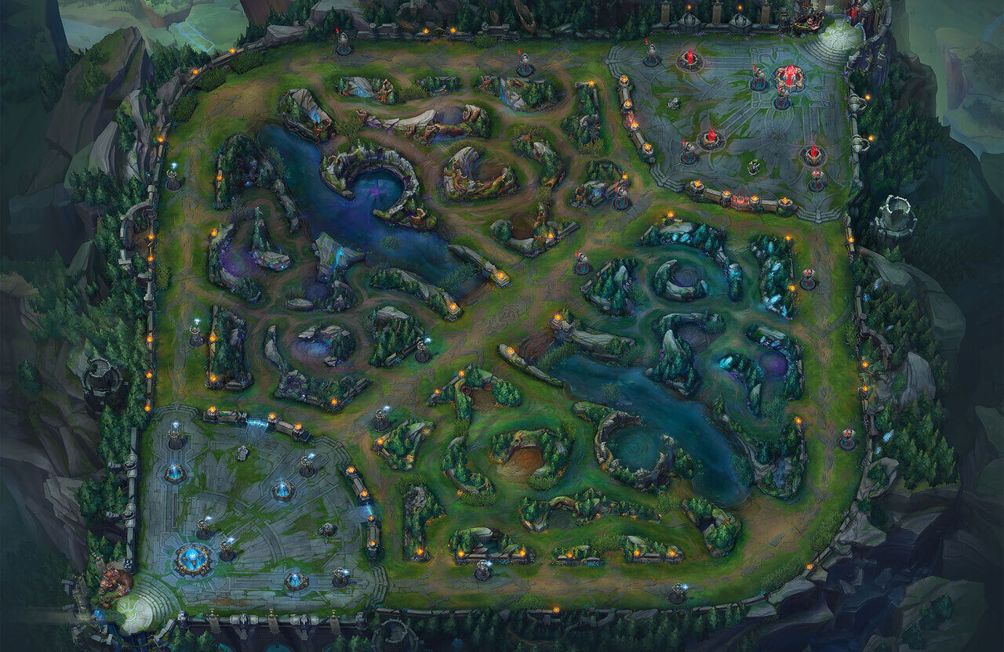


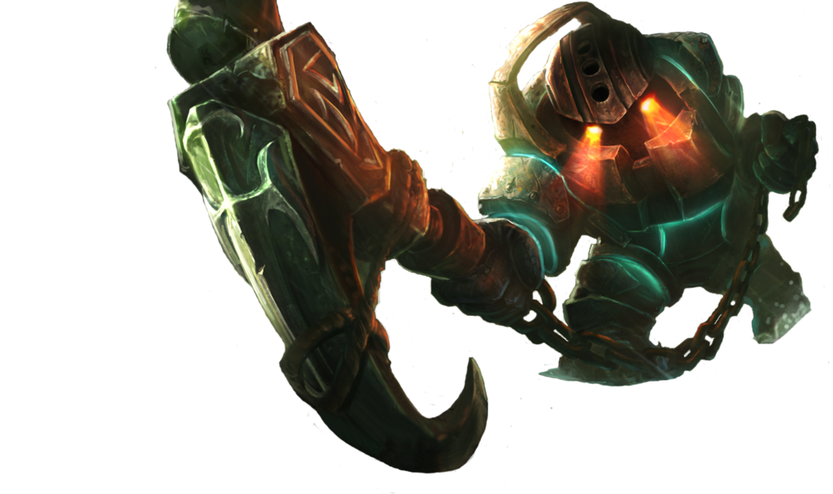

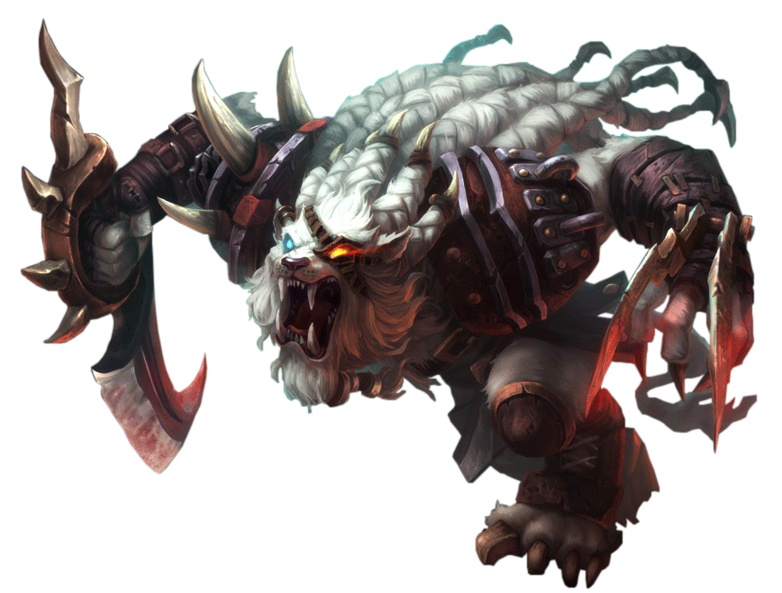
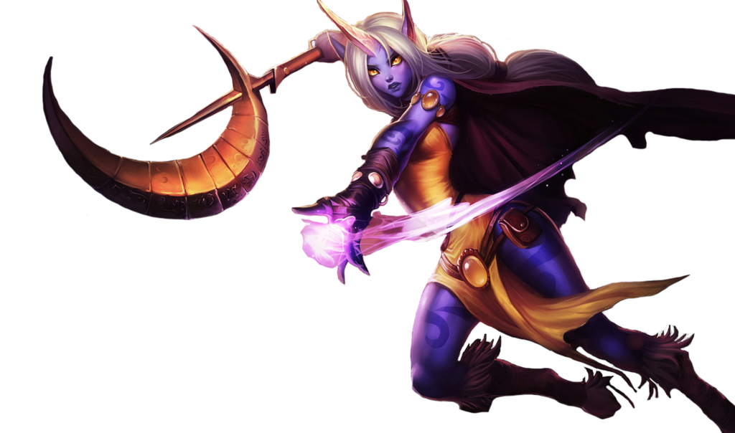

Champions, ROLES & POSITIONS
Composed of 5 unique champions (characters) per team.
Each player controls a champion:
Champions are a diverse set characters with their own set of abilities, strengths, weaknesses and classes.
Some champion classes examples are:
Notes:
In league of legends each player controls a champion, which is a powerful and diverse character with their own set of abilities, strengths, and weaknesses.
These champions are classified into different roles such as mages, warriors, tanks, supports, marksmen, and assassins each fulfilling a specific role/position within a team composition. The game is played in a map called the summoners rift with the 2 team’s bases are here and here and the positions. Top, Mid, Bottom (Bot) & Support and Jungle. Then each position is filled by a player who controls a champion.
The primary objective of League of Legends is to work together with your team to destroy the enemy's Nexus, a heavily fortified structure located within their base.

Slide 4
What composition for each position will maximize the chances of winnIng
Problem Definition #1
What is the best set of champion classes suitable for each position to achieve victory
To answer this, we have:
Acquired the necessary data we needed from the original dataset.
Sampled and prepared the data.
Performed data exploration and analysis (EDA).
Based on the observations and findings derived a conclusion.

Slide 5
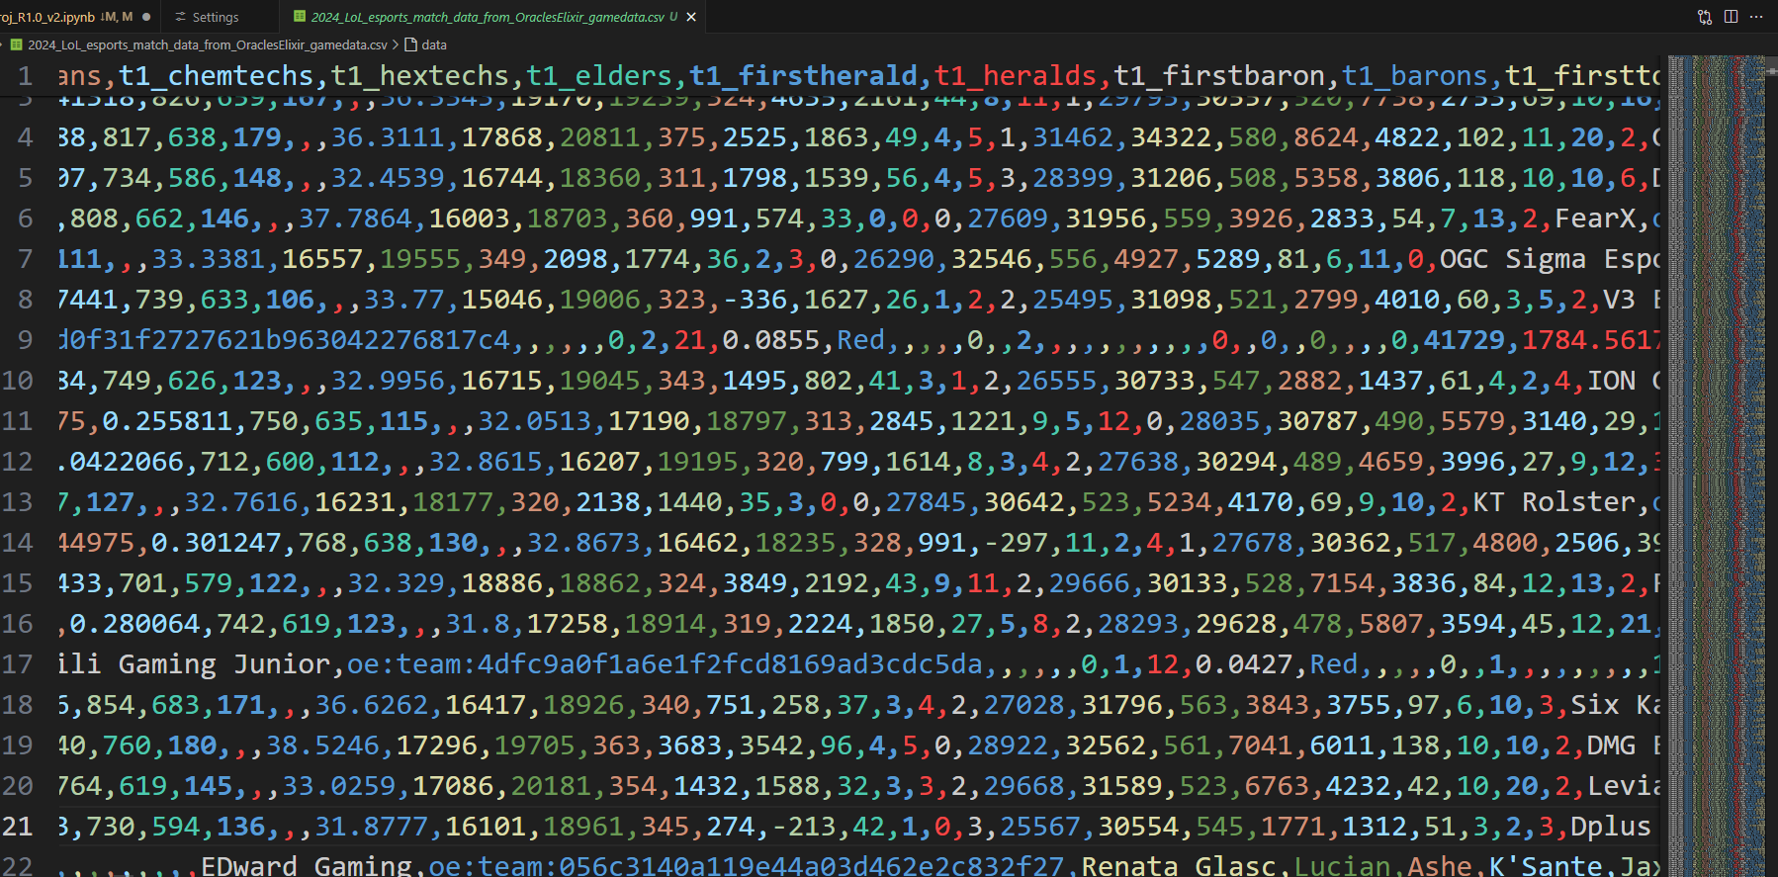
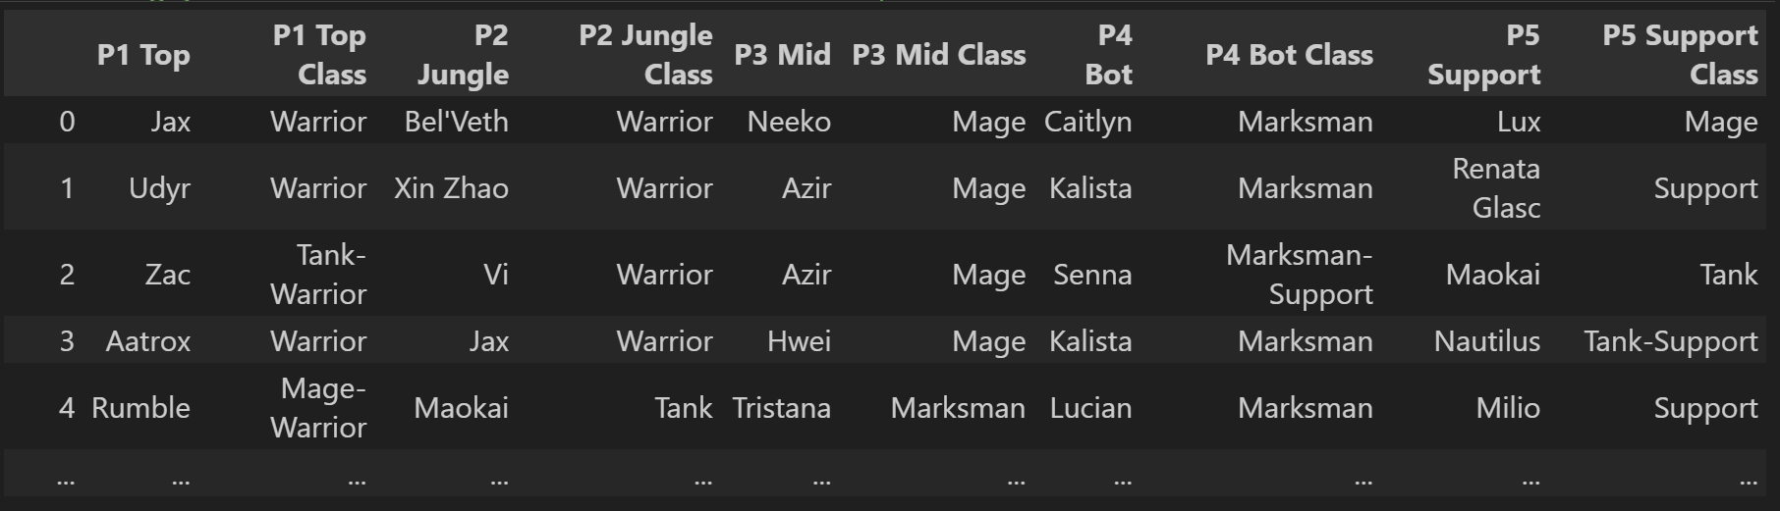
Sample collection & data preparation
Notes:
Due to the large size of the original dataset, we have extracted the necessary data needed from the dataset team champion compositions for winning games and the different champion classes that comes along with it.
Once we have prepared the dataset we proceeded with our EDA.

Slide 6

Exploratory data analysis

Slide 7
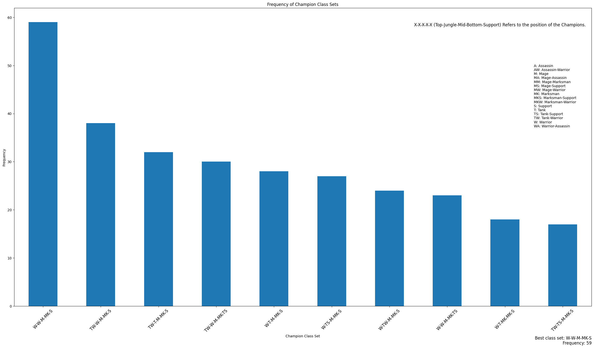
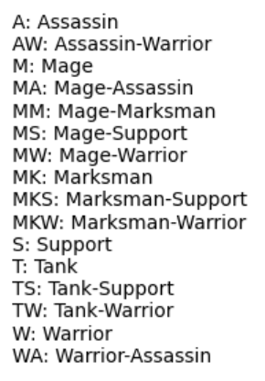
Bar Graph

Slide 8
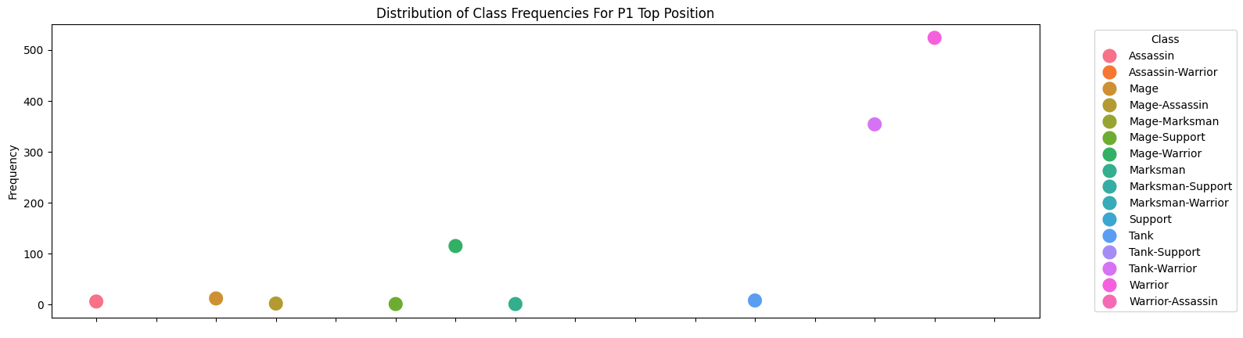
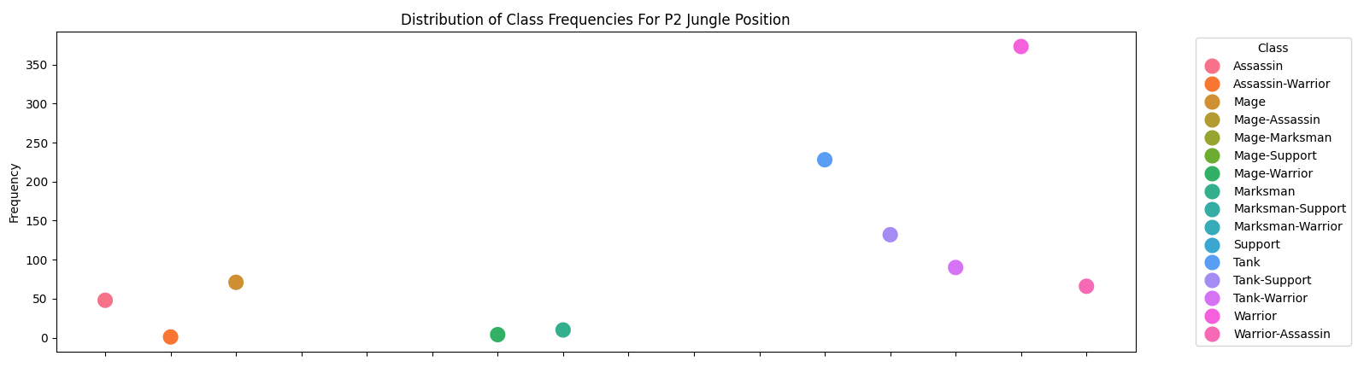
Scatter plot

Slide 9
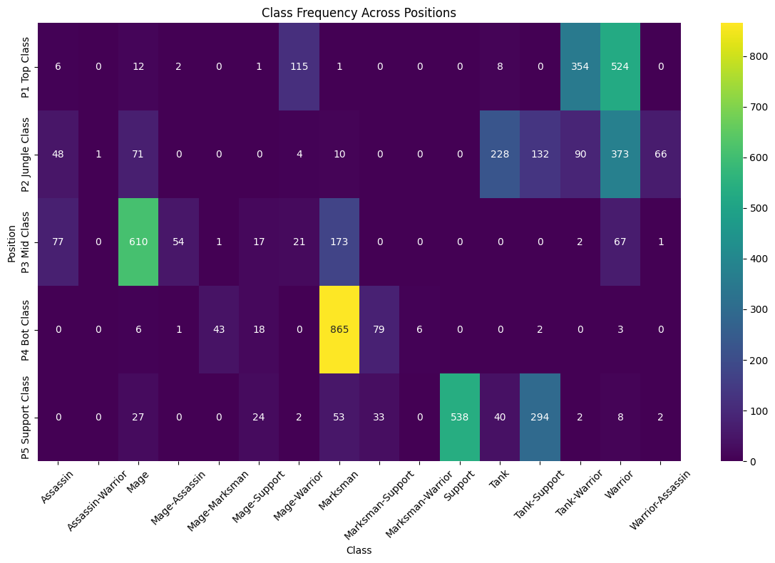
Heat map

Slide 10
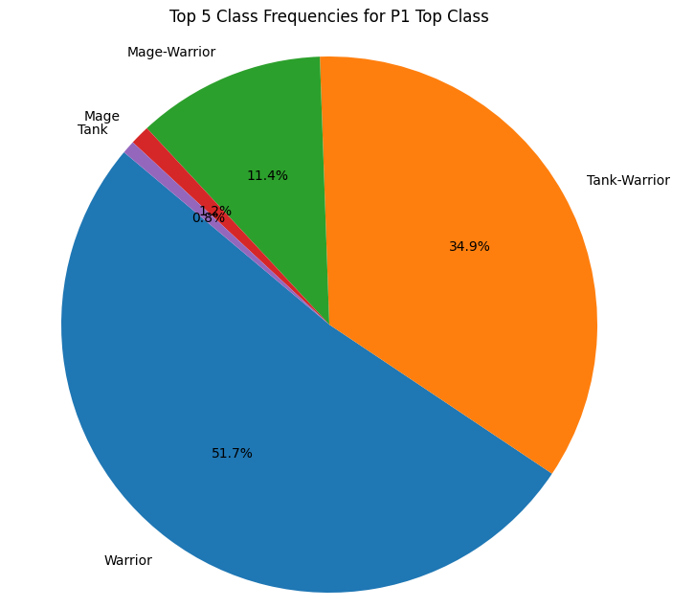
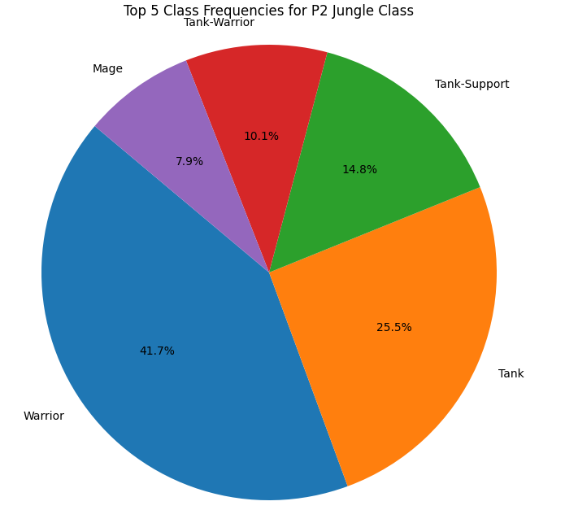
Conclusion

Slide 11
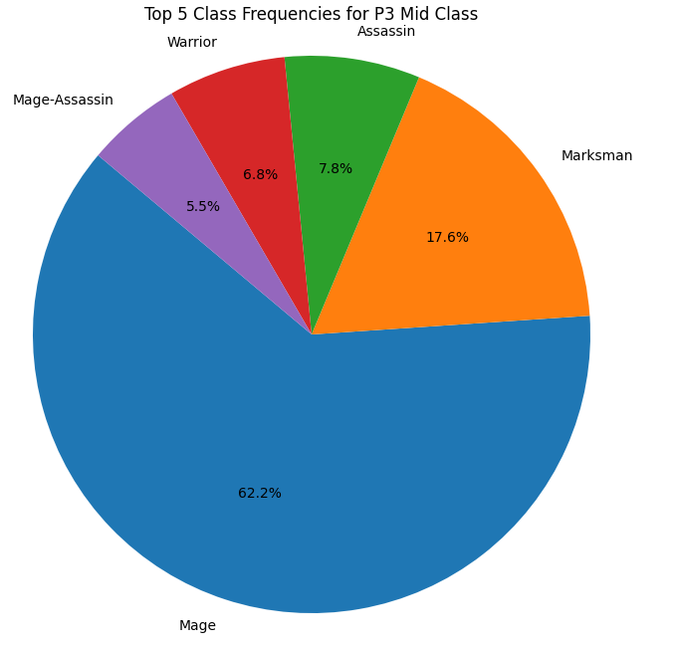
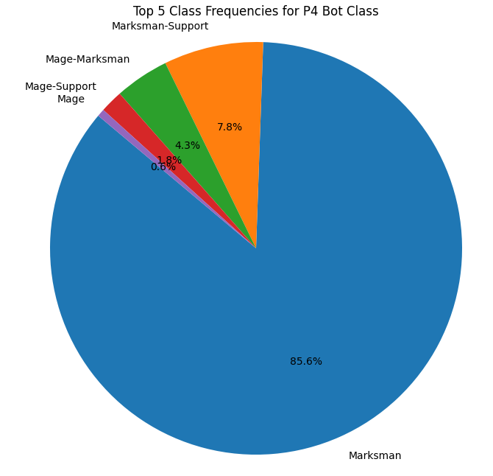

Slide 12
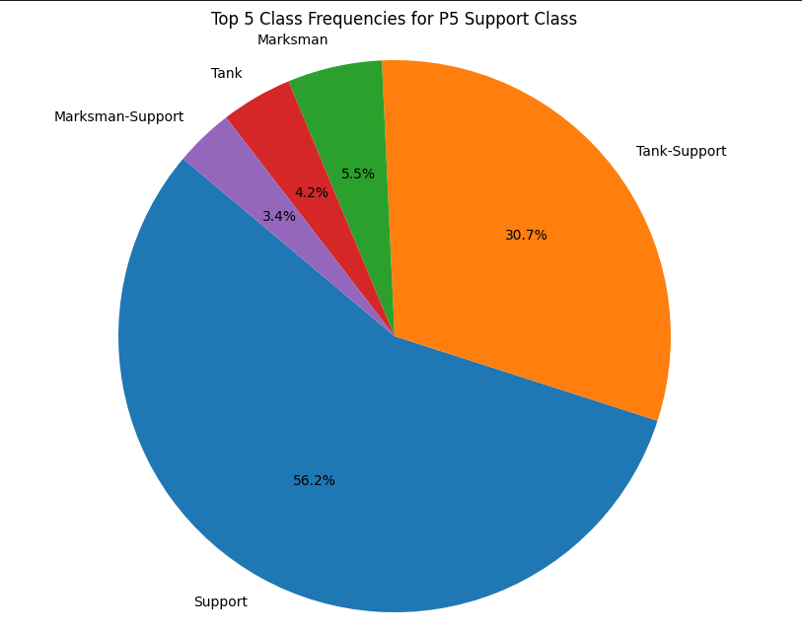
Top: Warrior JUNGLE : WARRIOR MID: MAGE BOTTOM & SUPPORT: MARKSMEN SUPPORT
Best team composition

Slide 13


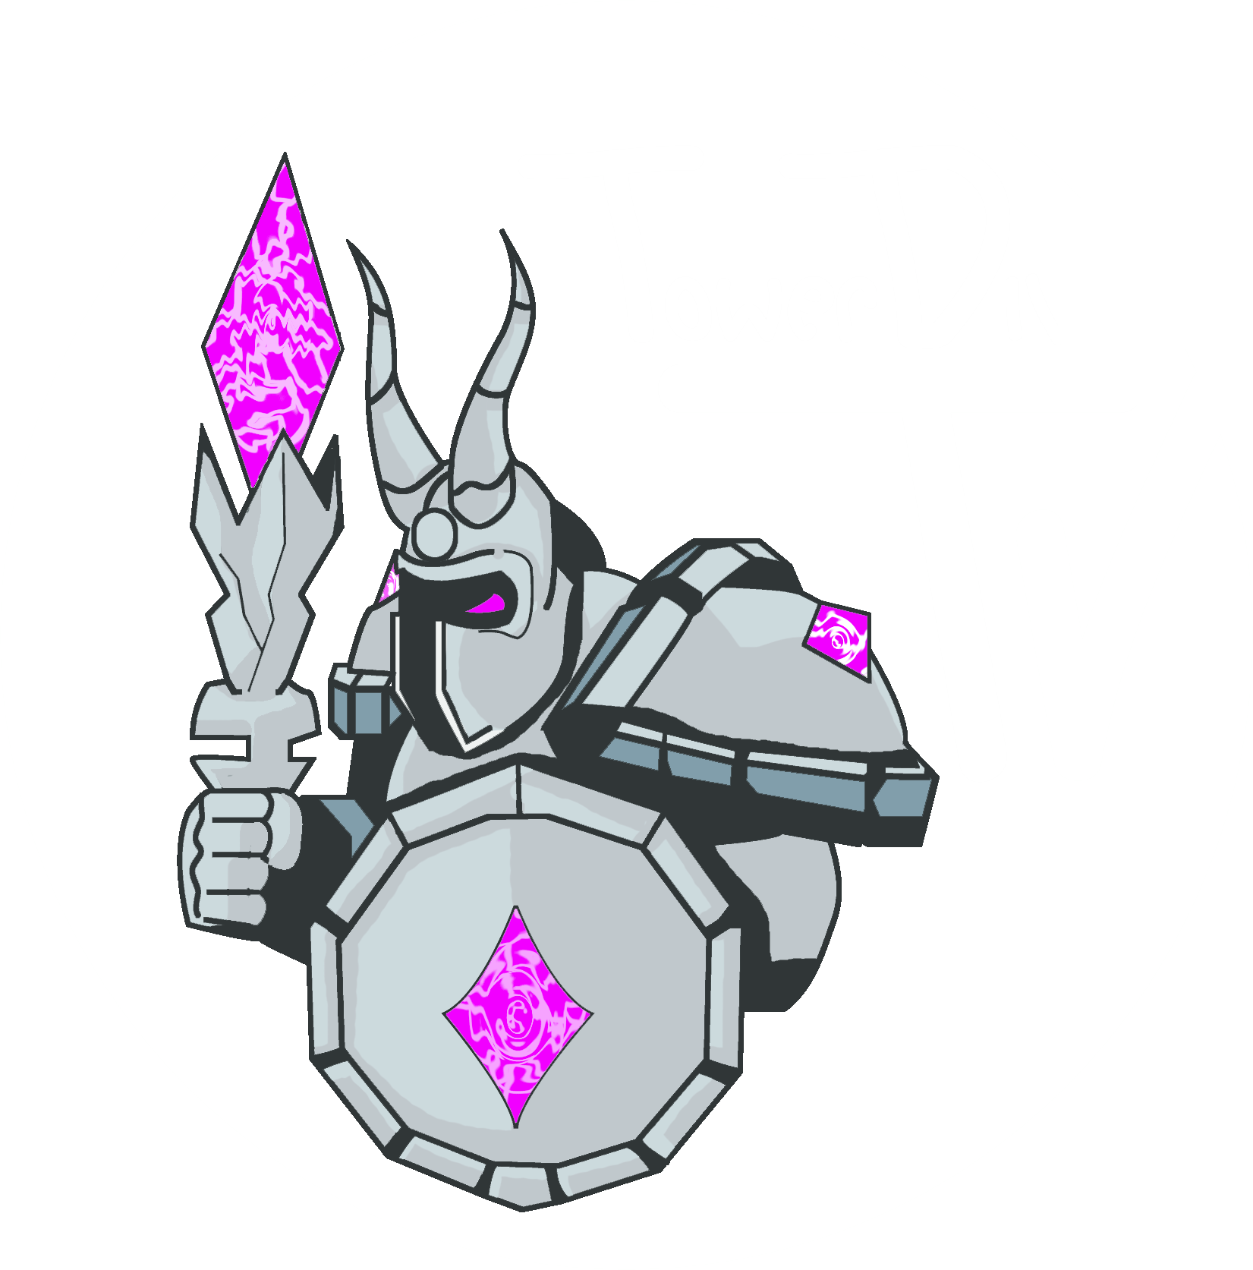


















LEAGUE OF LEGENDS IN-GAME GOLD SYSTEM
Gold is the primary in-game currency used in League of Legends.
It represents wealth and resources accumulated by players and the team during a match.
Gold is mostly earned by killing minions, neutral objective monsters, enemy champions and structures such as turrets and inhibitors.
Gold can be used to purchase items that provides stat boosts, passive and active effects to enhance a champion’s abilities and performance.

Slide 14
What composition for each position will maximize the chances of winnng
Problem Definition #2
What is the best set of champion classes suitable for each position to achieve victory
To answer this, we have:
Acquired the necessary data we needed from the original dataset.
Sampled and prepared the data.
Performed data exploration and analysis (EDA).
Based on the observations and findings derived a conclusion.

